Slide 1
Bikeshare Station Siting in Iowa City, Iowa
Hannah DeBruin, Civil Engineering
December 13, 2022, CEGE:5214

Slide 2

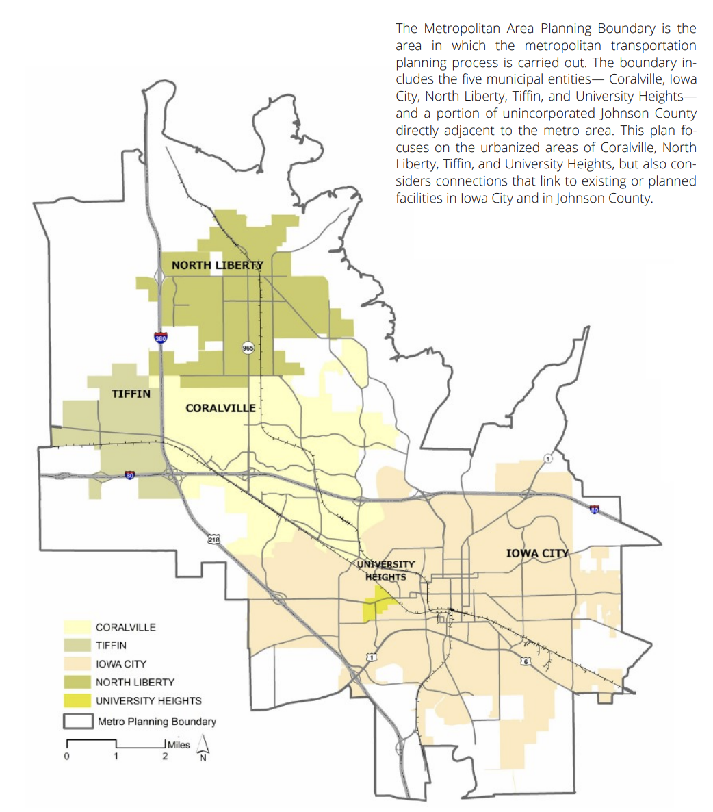
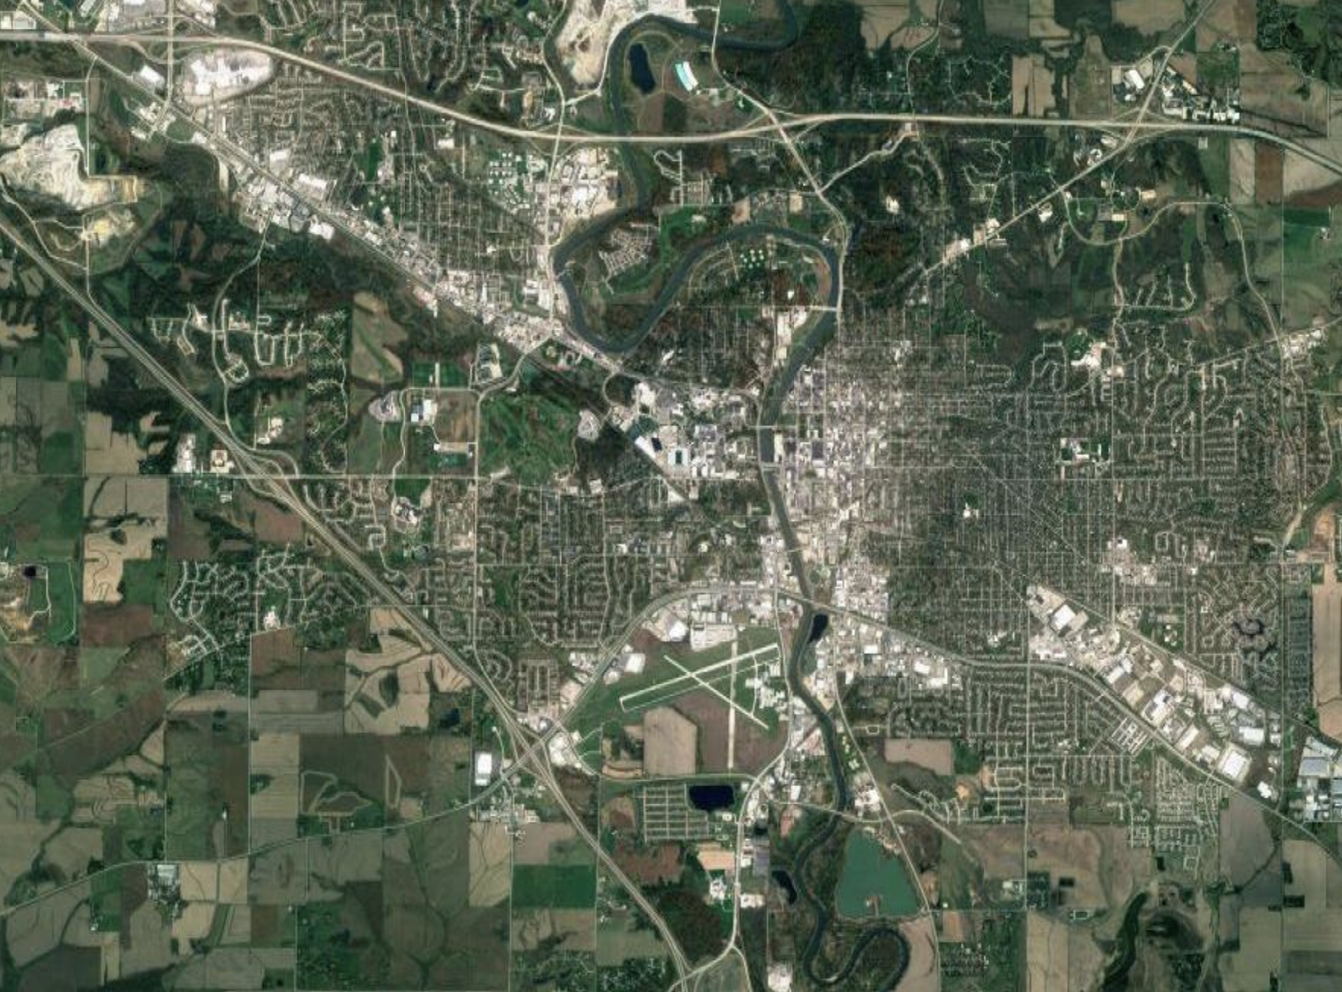

Problem/City Introduction
Population: 74,596
University of Iowa Student Population: 33,334
No existing bikeshare, though it has been attempted
Notes:
2015 – city and university started first partnership, but technology was evolving from docked to dockless systems, put project on hold
2018– put out bid for dockless version, began working and company wanted to use e-scooters, contract never concluded
2019- contracted with different mobility company, which was bought out by another mobility company, then faced supply chain shortages during the pandemic– contract basically halted again

Slide 3
Data Inputs - GIS
(same cell size, extent, snap raster)
Original Vector Data for Factor A
Rasterized Data for Factor A
Normalized Data for Factor A
Direct polygon to raster
X 10/max(A)
X % weight of factor A
Original Vector Data for Factor B
inverse Euclidean distance, buffered to 0.25 mile
Rasterized Data for Factor B
Normalized Data for Factor B
Combined Data with Spatial Index
X 10/max(B)
X % weight of factor B
Original Vector Data for Factor C
inverse Euclidean distance, buffered to 0.25 mile X value of interest
Rasterized Data for Factor C
Normalized Data for Factor C
X % weight of factor C
X 10/max(C)
File | Data Type
Transit Stops (with 2019 average daily boarding (ADB) ridership data) | Points
K-12 Schools (with # student) | Points
Top Employers for Iowa City (with # employees) | Originally points, digitized into polygons
Bike Facilities for Iowa City | Polylines
Traffic Analysis Zones (2018) (with # households, student residences) | Polygons
Recreation Facilities | Polygons
Commercial Areas (with # daily trips generated on average) | Polygons

Slide 4
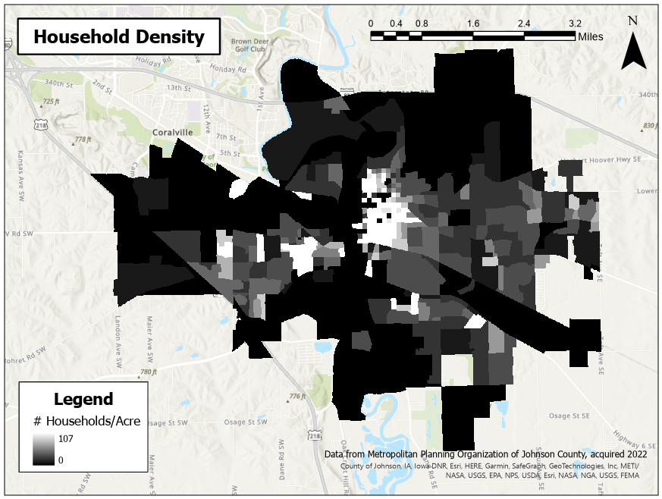
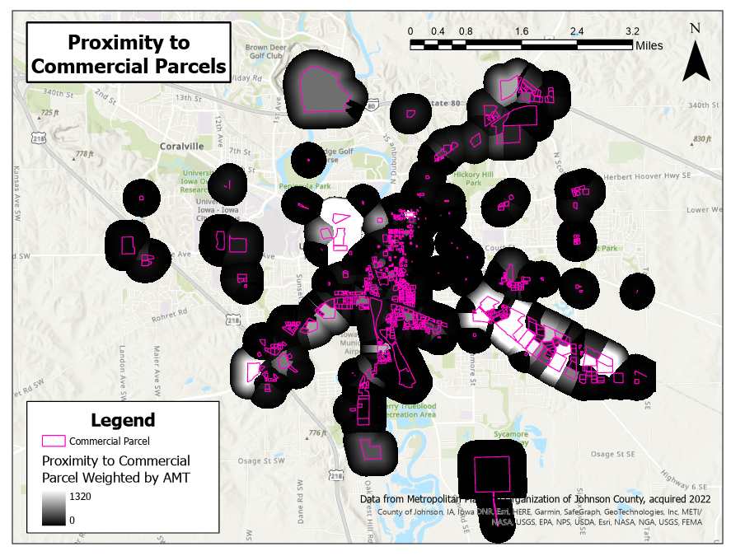
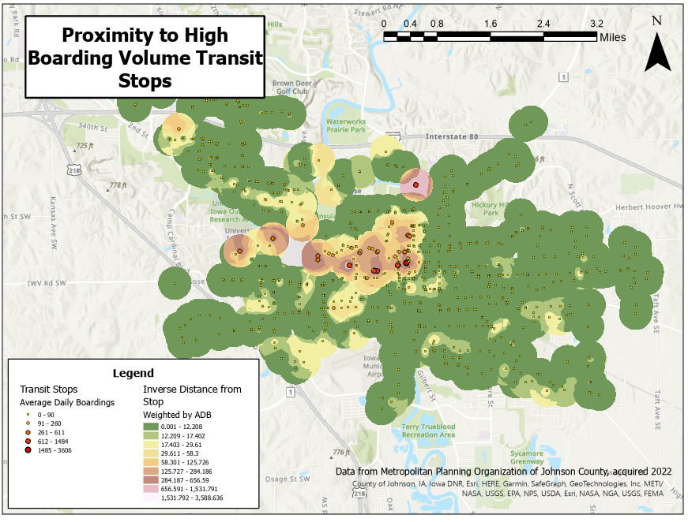
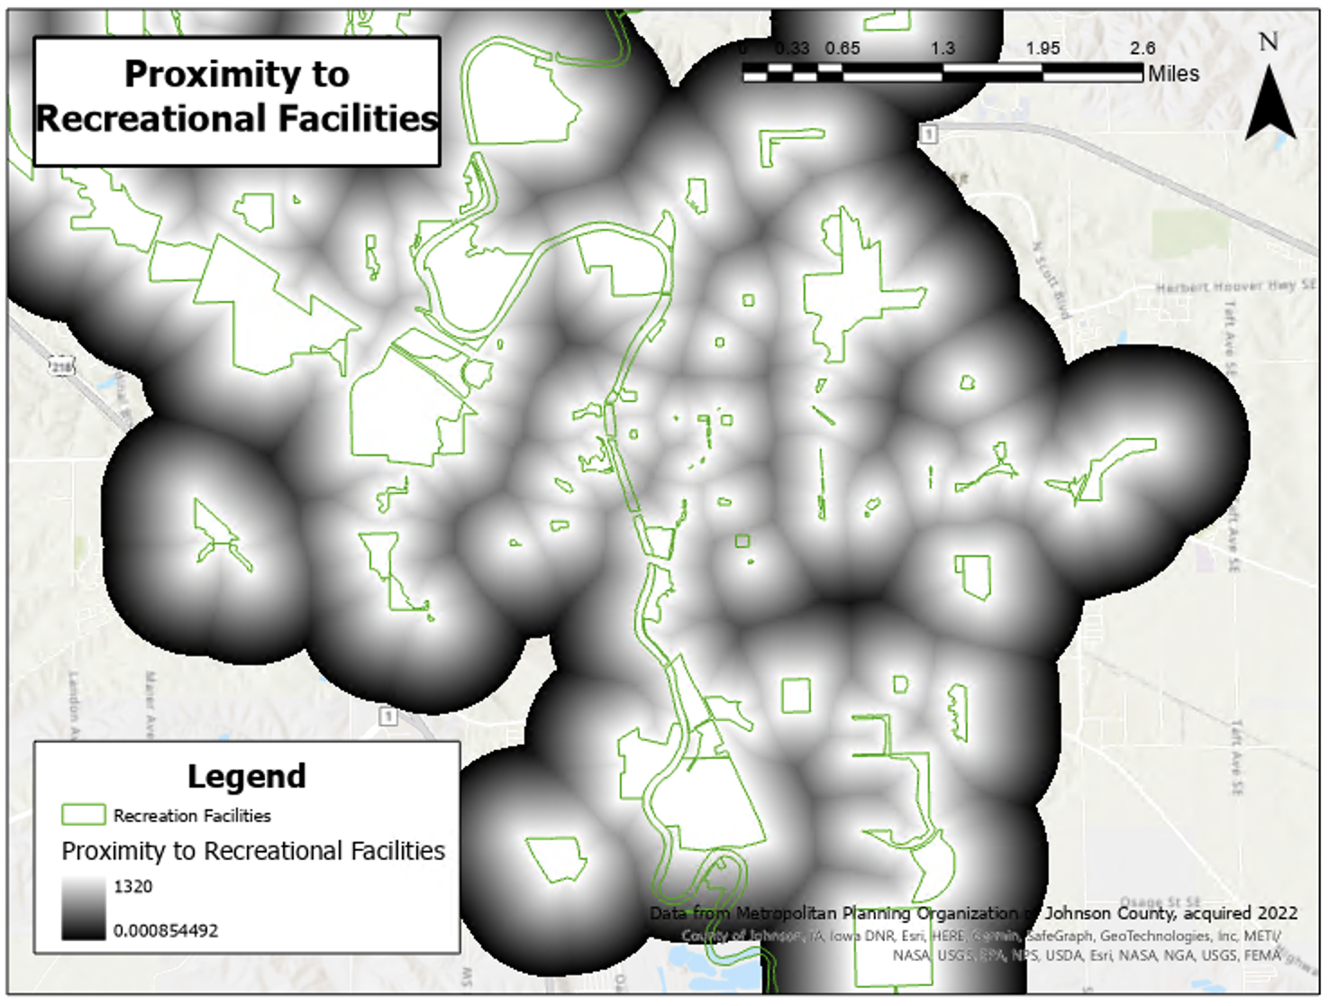
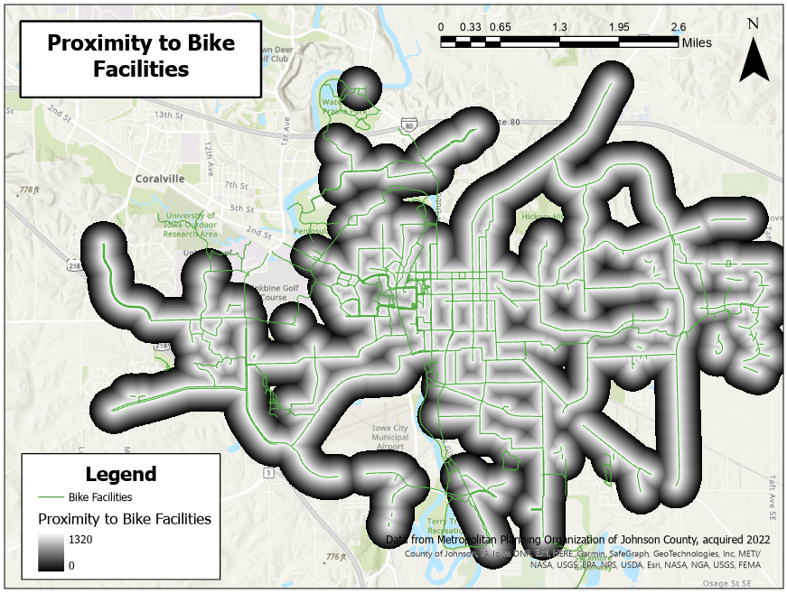

Slide 5
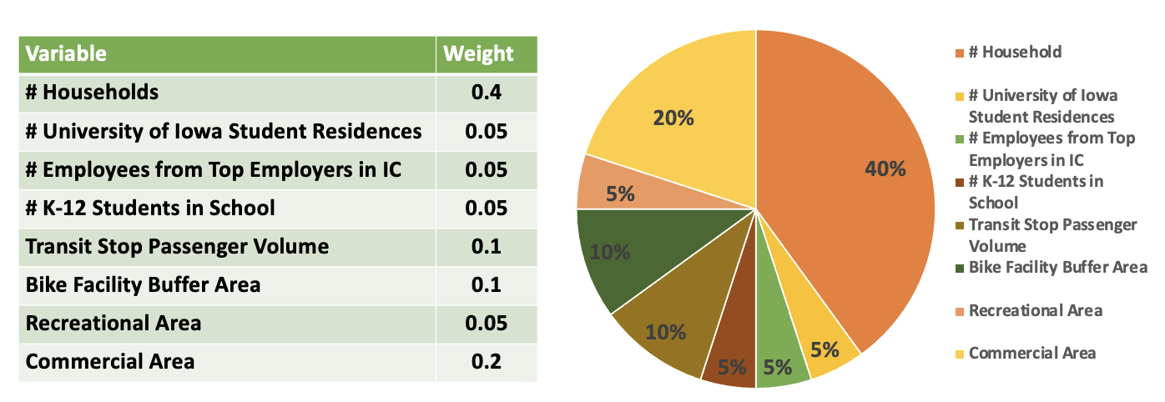
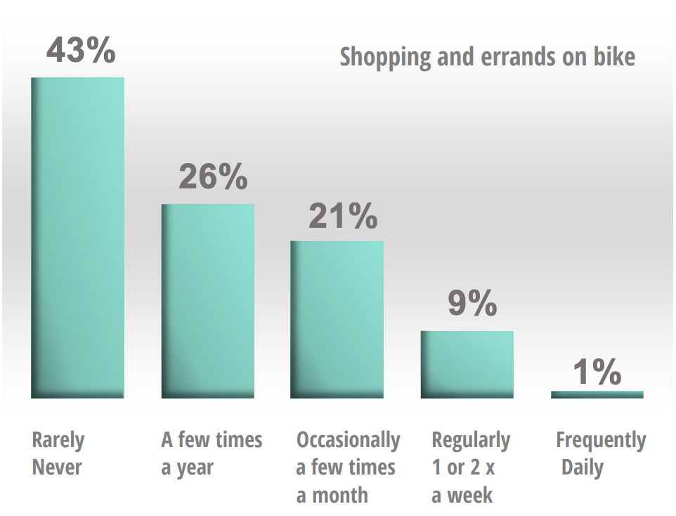
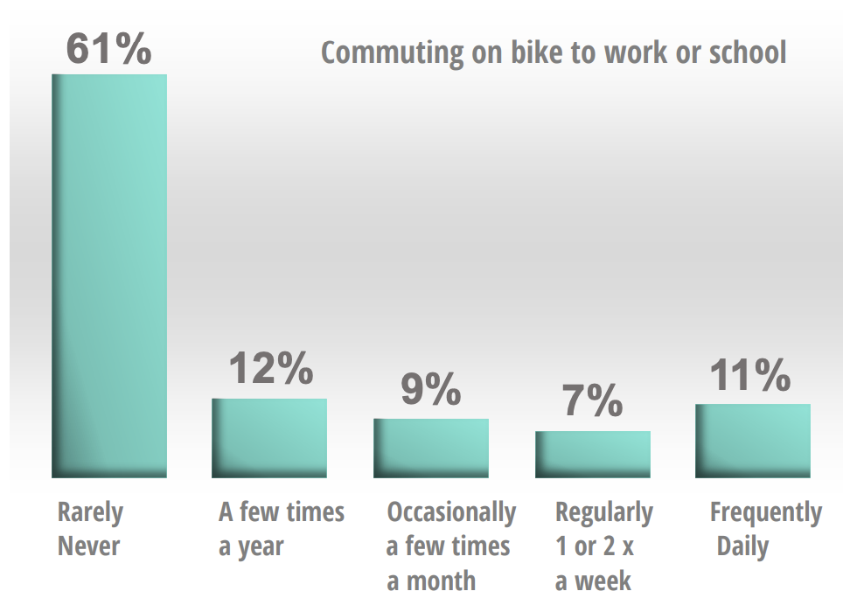
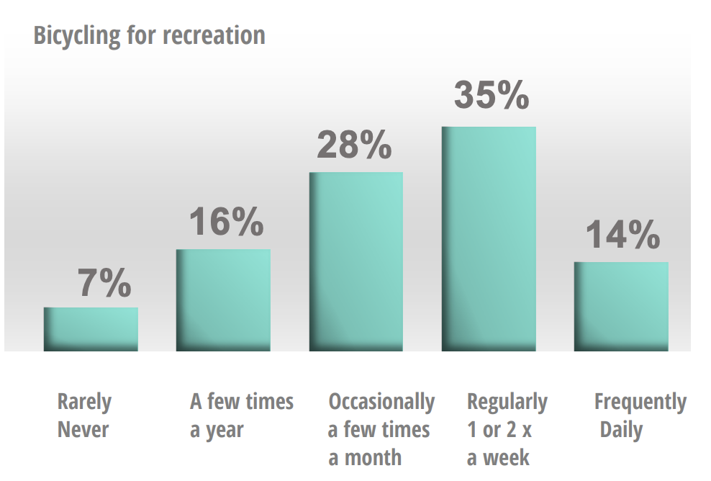
Weights of Factors
s/ Acre
/ Acre

Slide 6
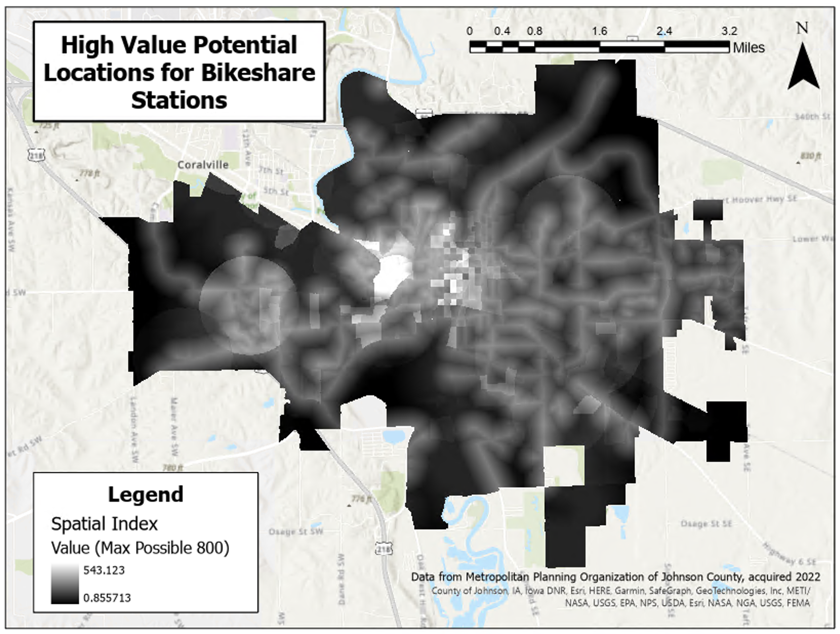

Slide 7
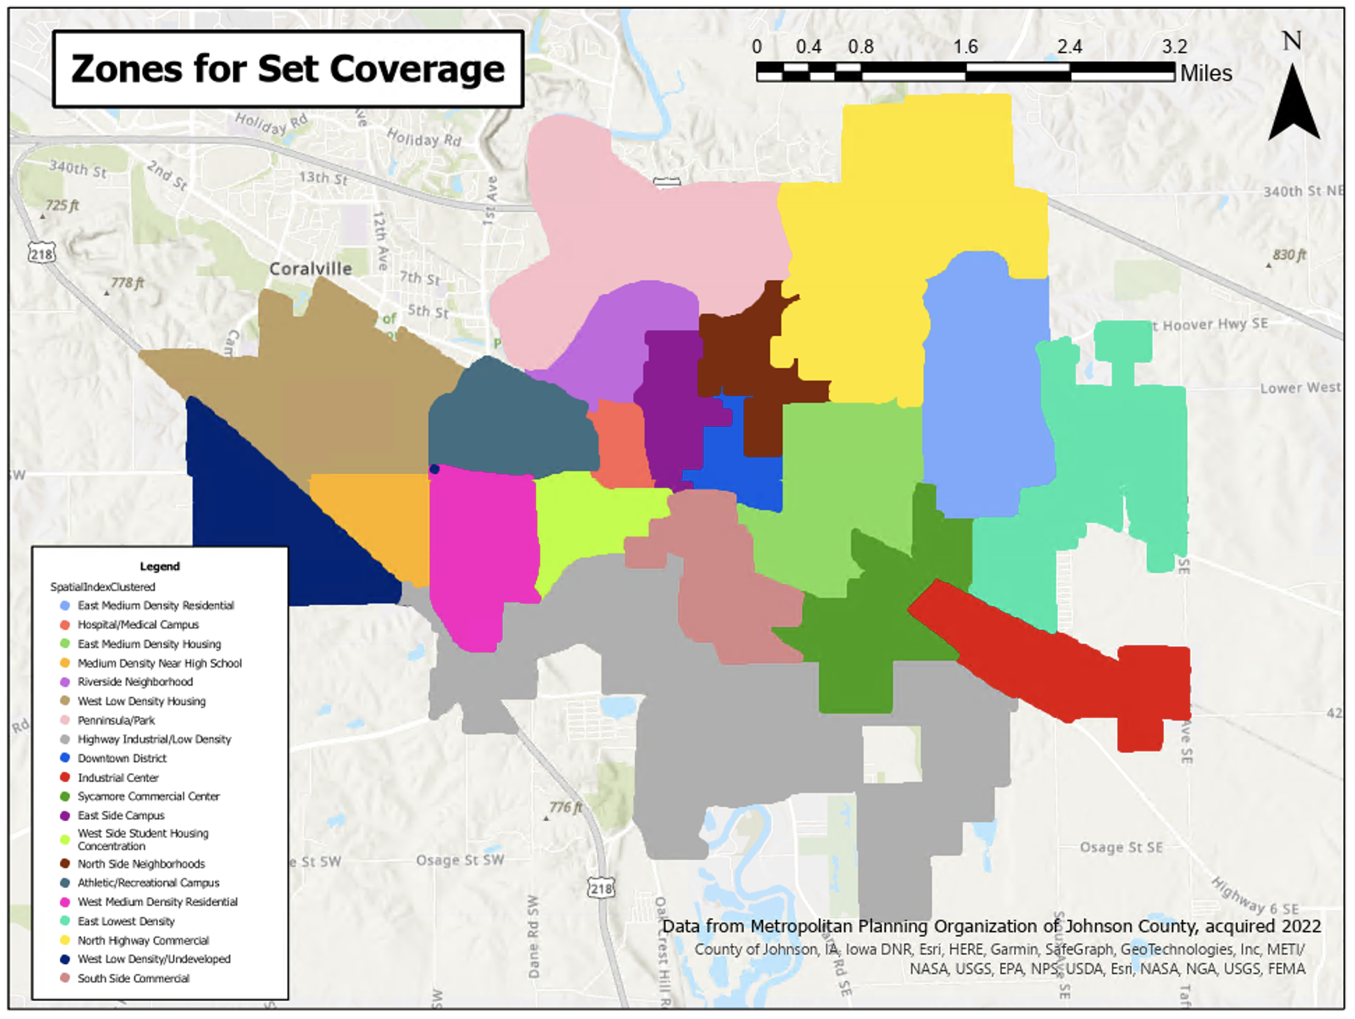

Slide 8
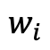
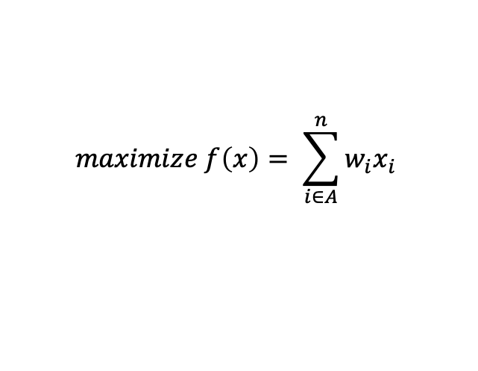
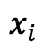
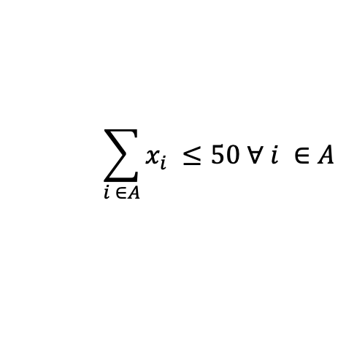
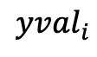
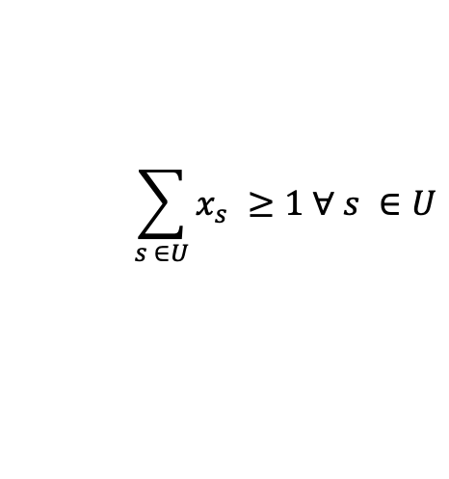
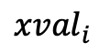
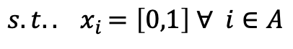
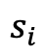
Discrete Optimization Problem
Decision Variables:
$$x_{i}$$
whether or not a station is assigned to cell i
Parameters:
$$w_{i}$$
calculated spatial index for cell i
$$s_{i}$$
assigned zone for cell i
$${xval}_{i}$$
x coordinate (ft) for cell i
$${yval}_{i}$$
y coordinate (ft) for cell i
$$maximize f\left(x\right)= \sum_{i∈A}^{n}{w_{i}x_{i}}$$
$$s.t. {. x}_{i}=\left[0,1\right] ∀ i∈A$$
discrete station placement
$$\sum_{i ∈A}{x_{i} ≤50 ∀ i ∈A}$$
budgeted max # stations constraint
$$\sum_{s ∈U}{x_{s} ≥1 ∀ s ∈U}$$
set coverage constraint
minimum spacing constraint
$$\sqrt{{{((x}_{i}∗{xval}_{i})−(x_{j}{∗xval}_{j}))}^{2}+{{((x}_{i}∗{yval}_{i})−(x_{j}{∗yval}_{j}))}^{2}}≥5280 ∀ i,j ∈A$$
Notes:
A = 176 candidate locations
U = 20 sets

Slide 9
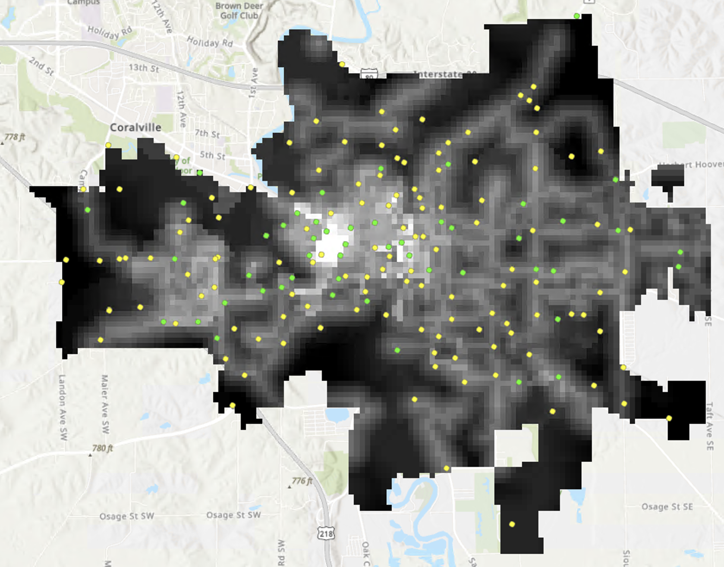

Slide 10


